Slide 1


Vaping Know The Risks
Photo from Unsplash.com

Slide 2

Adapted with permission from
Thunder Bay District Health Unit
Photo from Unsplash.com

Slide 3

TODAY’S AGENDA
Commercial Tobacco Review
What are Vapes?
Risks and Concerns
Nicotine Content
Aerosol vs Vapour
Laws and Rules
Photo from Unsplash.com

Slide 4
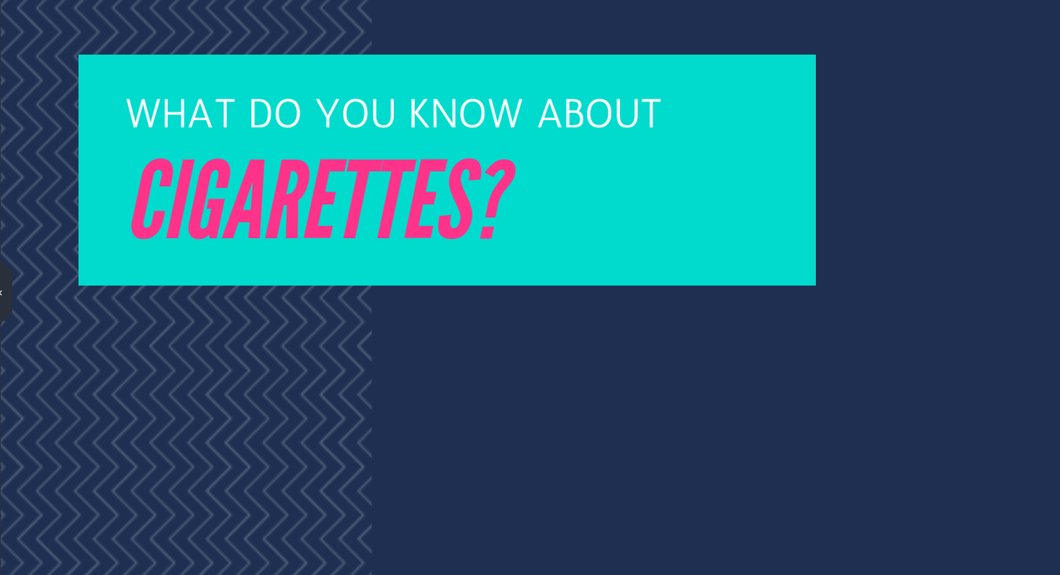
Notes:
Have students answer this question. (Options: Answer out loud or do a post-it note activity)
Try to get the a lot of answers (bad for you/health, addictive, chemicals, cost money, where you can’t smoke cigarettes etc)
Explain why you asked this question in a vaping presentation
I asked this question because there are more similarities to vaping and cigarettes that one might expect.
Vaping can be addictive just like cigarettes
Vaping has risks
Vaping is relatively new and we don’t know the long term health consequences (remember when the dangers of cigarettes were unknown?)

Slide 5

MORE THAN
7,000
CHEMICALS
ARE FOUND IN A
SINGLE PUFF
OF CIGARETTE
SMOKE
69
CANCER
CAUSING
CHEMICALS

Slide 6
SOME OF THE CHEMICALS…
BUTANE
TAR
LEAD
ACETONE
ARSENIC
CARBON MONOXIDE
METHANE
AMMONIA
FORMALDEHYDE

Slide 7
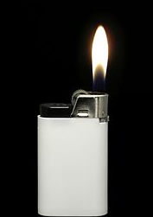

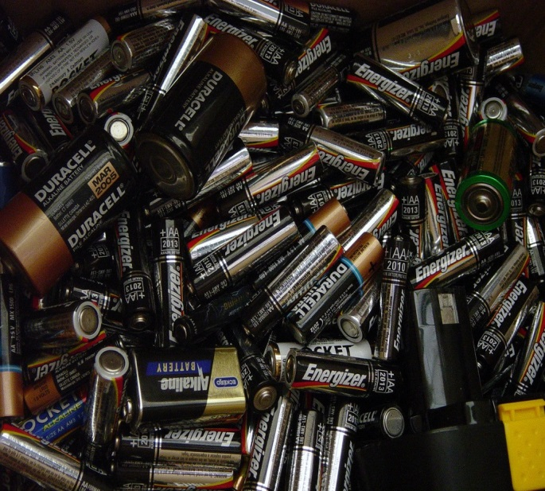
WHERE ELSE ARE THESE CHEMICALS FOUND?
TAR
BUTANE
LEAD
Pavement
Batteries
Lighter Fluid
Notes:
Ask students where they find the ingredients.
Where do you find tar? Click for answer
Where do you find butane? Click for answer
Etc.

Slide 8

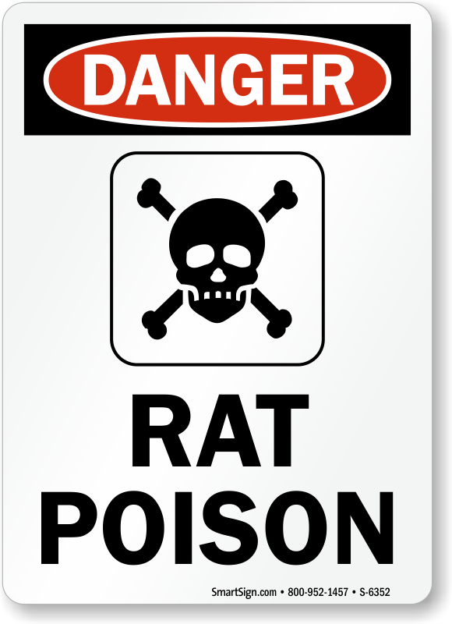
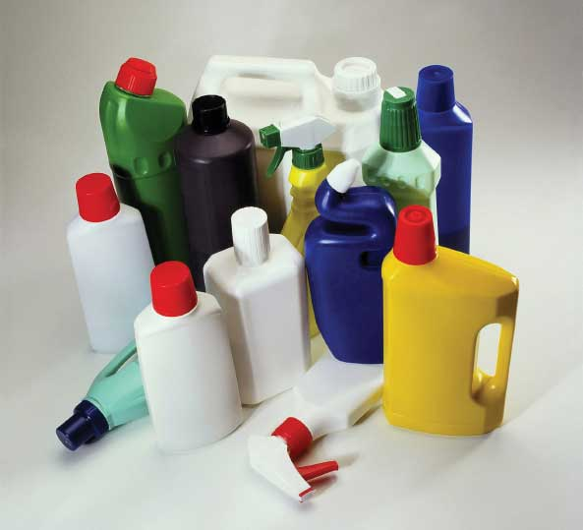
WHERE ELSE ARE THESE CHEMICALS FOUND?
ACETONE
ARSENIC
AMMONIA
Nail Polish Remover
Household Cleaners
Rat Poison

Slide 9
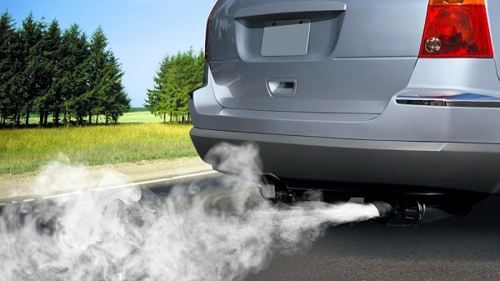


WHERE ELSE ARE THESE CHEMICALS FOUND?
CARBON MONOXIDE
FORMALDEHYDE
METHANE
Car Exhaust
Cow Farts!?
(Also landfills and natural gas leaks)
Preservatives

Slide 10
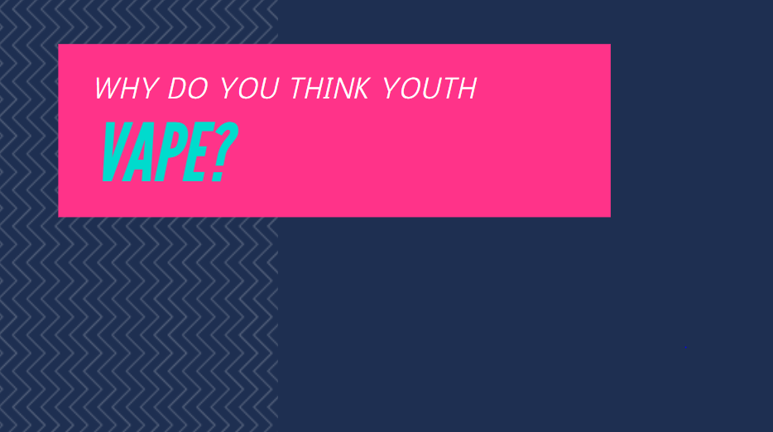
Notes:
Try to get answers such as “safe/harmless, tastes/smells good, it’s cool/fun, friends do it/share etc
(Option: Answer out loud or do a post-it note activity)

Slide 11
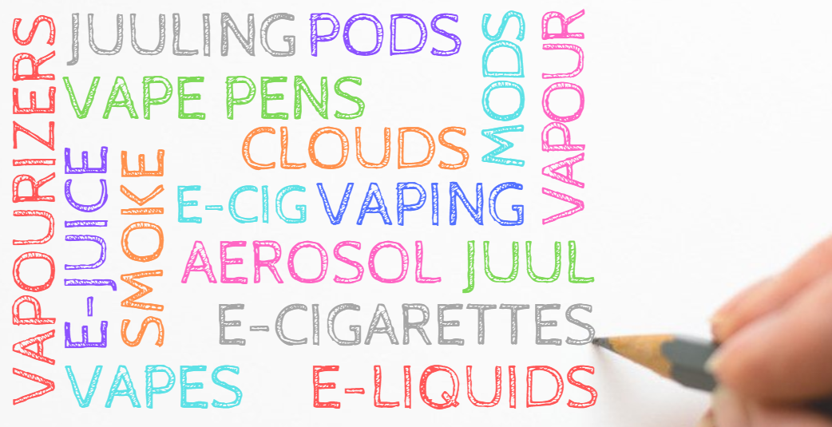
Notes:
Explain that in this presentation you might interchange some terms but explain that you are referring to the same thing - vaping!
Also explain how you might interchange:
vapours/smoke/aerosol/clouds
E-cigs/vapes/Juuls/Mods/Pens
E-Juice/e-liquids/pods/cartridges
Explain how they were originally known as e-cigarettes/e-cigs when they first came out because they were designed to help people quit smoking.
But now, they want to distance themselves away from the word “cigarette” because cigarettes are known to be bad for people

Slide 12
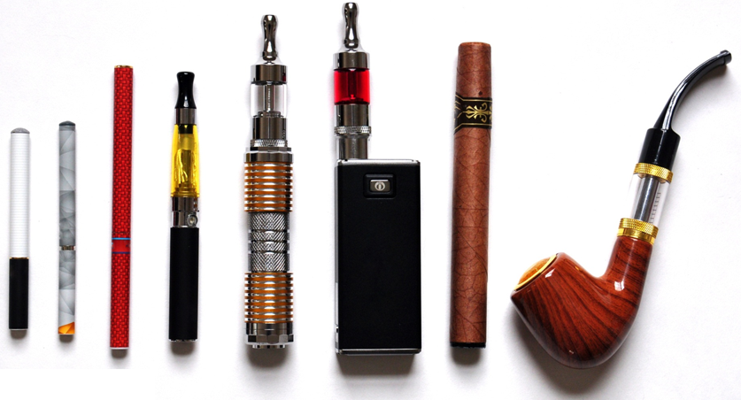
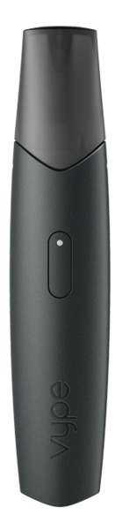

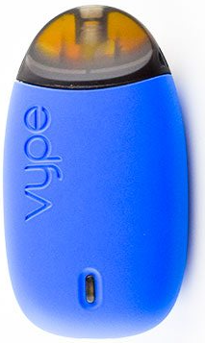
1st Generation
2nd Generation
3rd Generation
Novelty
Pod/Cartridge Based
Cig-a-likes [disposable]
Vape Pens, Tank Systems, Mods [refillable e-juice]
Juul, ePen, disks [pod system]
Notes:
Some claim they have the potential to help smokers quit smoking.
1st Generation/Cig-a-Likes
Came into market around 2007
Most delivered nicotine and were disposable
2nd Generation / Vape Pens
Reach higher temperatures
Refillable with e-juice/e-liquids
Users can regular the frequency of inhalations (heat more or less e-liquid/breath)
3rd Generation / Mods
Can control the temperature
Can control the amount of aerosol, nicotine
Pod/Cartridge
New technology / unconventional designs (discrete)
Juul considered the ‘iPhone of vapes’ – looks like USB drive
Pods often contain higher amounts of nicotine
When someone tells us that they are using a vaping product to quit smoking, we often ask them if they have a quit date for the vapes.

Slide 13
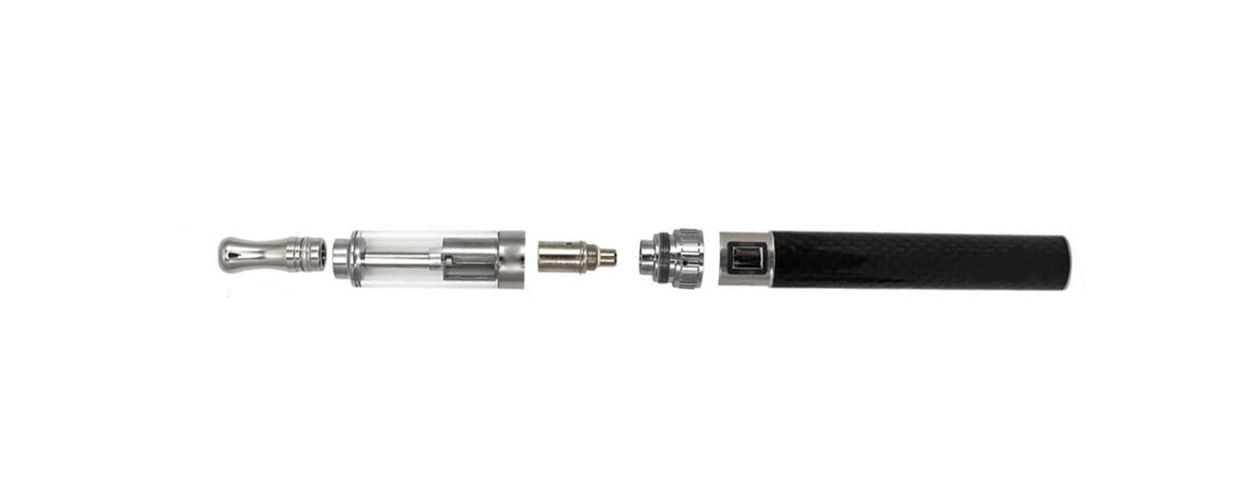
How Does an E-Cigarette Work?
Mouthpiece
Tank
Atomizer
Battery
Used to inhale the vapour / where the vapour is released.
Tank/Pod/Cartridge that holds the e-juice.
Refill the tank or replace the pod or cartridge.
Heats up the e-juice to create the vapour.
Batteries are used to power the device.
Vapes may look different but they generally work the same way and have these components.
Notes:
Vapes may look different but they generally work the same way and have these components.

Slide 14

=
Big Tobacco Big Vapes
Photo from Unsplash.com
Notes:
Vaping is now a multi-billion dollar industry
So there is no surprise that Big Tobacco owns their own vaping brands and devices.
Some of the most popular vaping brands are owned by Big Tobacco companies
They are using their old tobacco marketing tricks with new vaping products to attract new customers to vaping.
Tricks: Youth appealing/fun/glamorous marketing and advertising, youth flavours, fancy packaging

Slide 15


Less harmful does not mean safe!
Are vapes safe?
Notes:
Ask students if they think vapes are safe. Ask why they think they are safe or not safe.
Ask if they think that vapes are safer than cigarettes.
(Click on slide to show animation)
E-cigarettes are also known as nicotine delivery devices that are designed for SMOKERS who want to quit smoking
E-cigs might be less harmful that smoking, but less harmful doesn’t mean safe!
If they don’t smoke, but vape, then already it’s more harmful to their health!
The vapours/aerosols expelled contain harmful chemicals and metals

Slide 16


Multiple Choice
Long-term consequences of vaping
a) are unknown
b) are considered safe
c) are very harmful
Photo from Unsplash.com
Notes:
Remind students that it took 20-30-40 years before we knew smoking was bad for you.
When cigarettes were first introduced no body knew how harmful and addictive they were.
Vaping is relatively new and we won’t know the long-term consequences of vaping for many more years.
Ask the students a rhetorical question: Do you want to be the test subjects?

Slide 17

Health Risks
Nicotine Addiction
Brain Risks
Behaviour Risks
Aerosols & Other Risk
Exposure to Metals/Chemicals
Throat Irritation
Lung Irritation
Risk of Cigarette Use
Photo from Unsplash.com
Notes:
We may not know the long-term consequences of vaping but we do know some short-term consequences.
Nicotine Addiction – youth get addicted to nicotine quicker and at lower doses
Brain Risks – affects focus, concentration, learning
Behaviour Risks – You start making riskier decisions on vaping – maybe vaping in the bathroom, or on school property, hiding things from your parents
Aerosols – we’ll talk more about it later on, but know that there are chemicals and metals in the vapours
Risk of cigarette use – Tie back to the opening side where you asked them what they know about cigarettes. Most would have said they are bad for you and probably wouldn’t start.
But if you have an addiction to nicotine, the likely hood of starting to smoke is 4x greater!

Slide 18


Notes:
Copy and Paste Link to video if clicking play button doesn’t work:
https://www.youtube.com/watch?v=wr8AsbPMSjM
(4x more likely to smoke video)

Slide 19


Ingredients
Glycerol Flavouring Propylene Glycol
Varying Nicotine Levels
Photo from Unsplash.com
Notes:
Glycerol – colourless, odorless liquid that is sweet-tasting – Commonly found in food industry as a sweetener
Propylene Glycol – liquid commonly found in fog/smoke machines
Ingredients might be safe to ingest (eat) but when unsure if safe to inhale (breathe in) when heated up

Slide 20
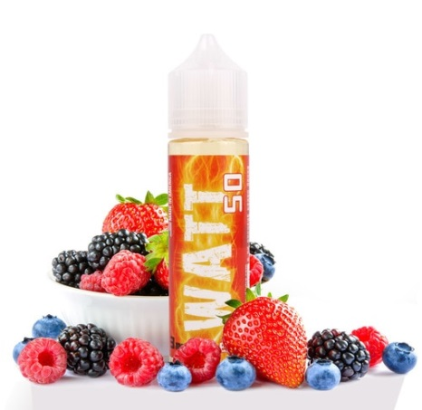

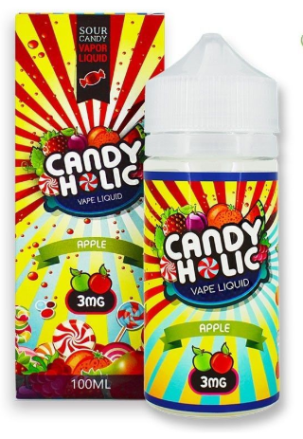

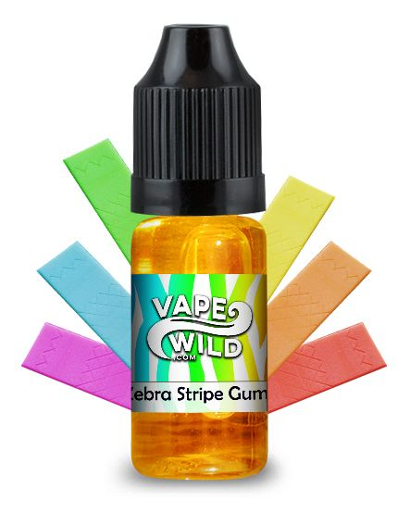
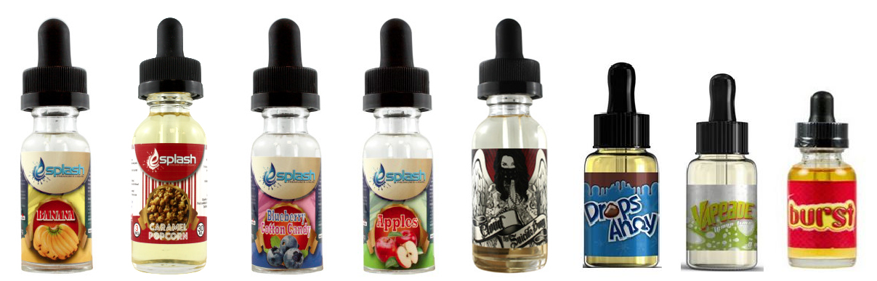
Flavours
There are over
15,500
[unregulated] e-juice / pod flavours.
Notes:
Ask Students: Does any know what “unregulated” means?
Explain that most of the flavours are not tested before they go on sale.
Don’t know if they equipment used was clean/sanitary
Don’t know what chemicals are being inhaled when heated
Don’t know if the ingredient list is accurate
Ask: Why do you think there are so many flavours?
Answer: Hides bad tastes, makes them a conversation starter (have you tried….yet?), flavours attract kids!

Slide 21
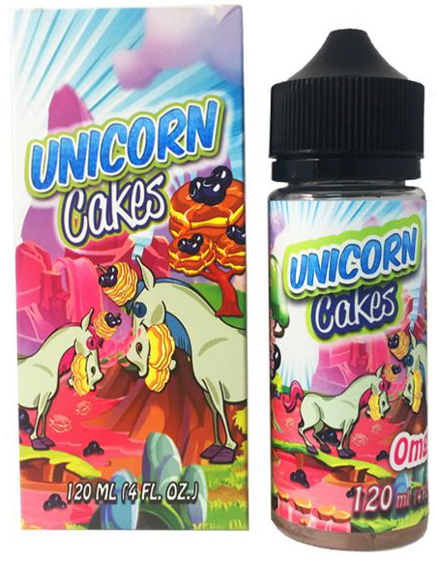
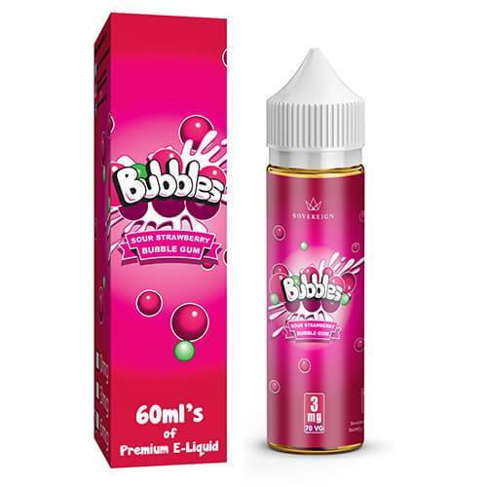
Question
Who do you think they are targeting with flavours like cotton candy, bubble gum and unicorn cakes?
Notes:
If you get the answer: “kids or children”
Ask: “Why do you think they are targeting kids/children”
Relate back to Big Tobacco companies and their marketing tricks
Get kids addicted so they have life-long customers
If they don’t kids addicted they will be out of business

Slide 22
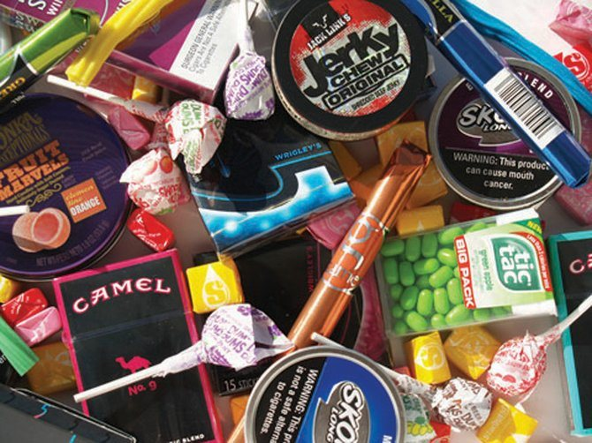
Do you remember when tobacco products looked like candy and snacks?
Well…

Slide 23
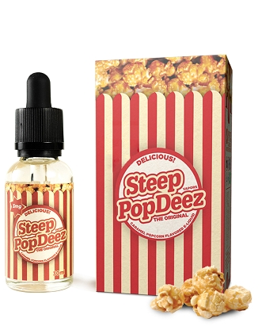
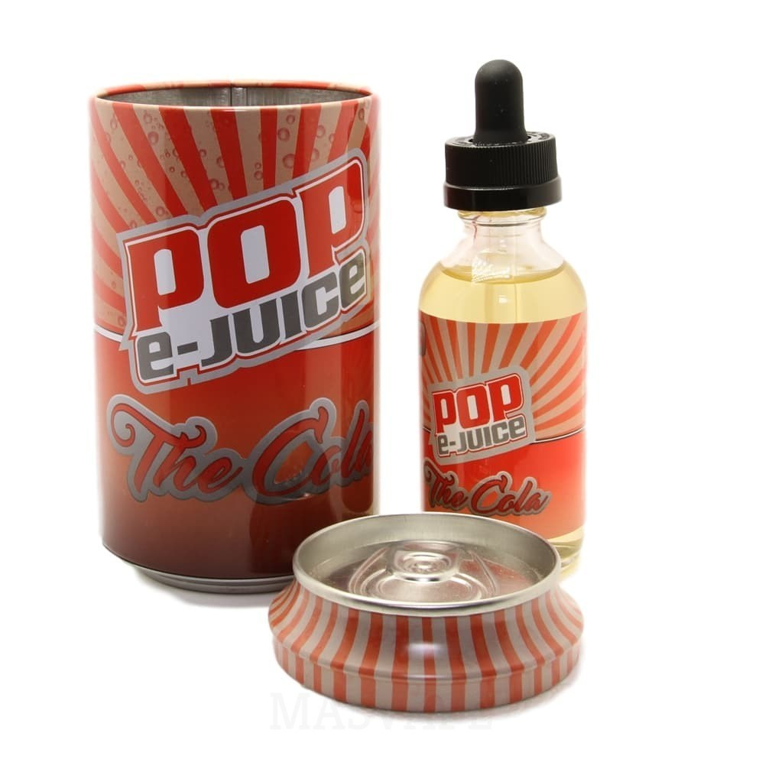
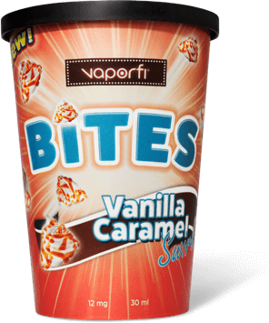
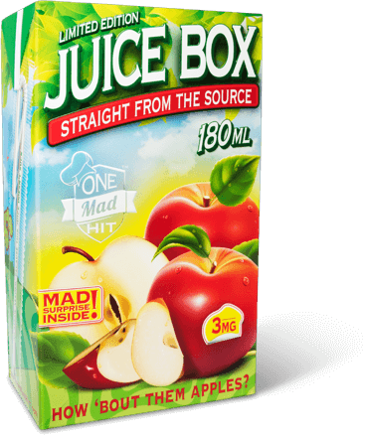
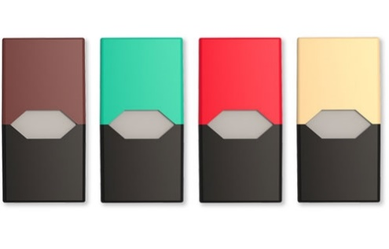
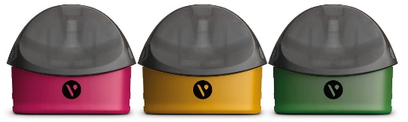
Packaging
E-juice companies are doing the same things tobacco companies did to target youth!
Notes:
The e-juice companies are doing the same thing. They are making packaging and labels look like normal everyday products!
Discrete packaging/containers that hide e-juice and devices
Appealing to youth
Hard for adults to spot
It took years for of before the government banned flavoured tobacco and working towards plain packaging –
Plain packaging means all packaging must look alike and can’t have flashy colours or mimic candy products

Slide 24
VS
Cigarette Ads
Vaping Ads
How are the following ads making smoking and vaping look?
Photo from Unsplash.com
Notes:
Cigarette companies spend billions of dollars to market and promote their products to try and get new clients.
In 2016, the US tobacco companies spent over 9 billion dollars on marketing and promotion alone! And in Canada it was about 700 Million! Just think how much money they are making if they are spending this much to advertise!
Vaping companies have seemed to follow the tobacco companies marketing strategies to try to get clients. Remember how we said the major tobacco companies now own vaping brands? Well they are using their old tricks to promote their vaping products.
Even though they know their products kill their clients they don’t market it that way. Lets take a look at how they market their products.

Slide 25
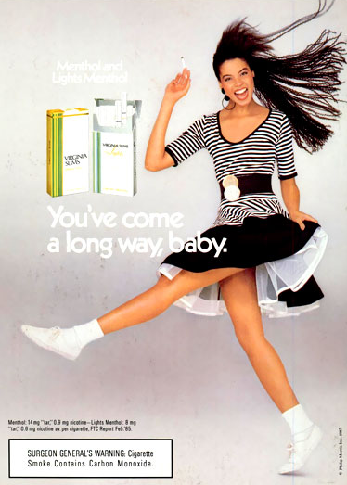

VS
Cigarette Ad
Vaping Ad
Photo from Unsplash.com
Notes:
Looks like its fun, care-free, harmless

Slide 26


VS
Cigarette Ad
Vaping Ad
Photo from Unsplash.com
Notes:
Makes it look cool, hip, relaxing

Slide 27


VS
Cigarette Ad
Vaping Ad
Photo from Unsplash.com
Notes:
Stylish, trendy, sophisticated

Slide 28
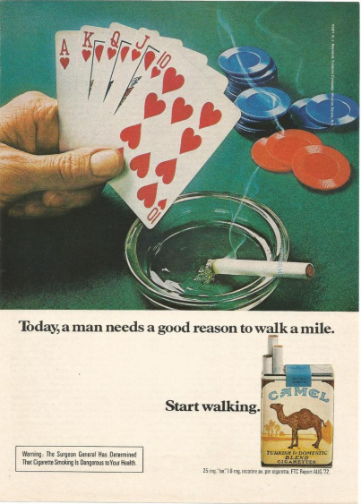

VS
Cigarette Ad
Vaping Ad
Photo from Unsplash.com
Notes:
Risk taking, swag, player, baller

Slide 29

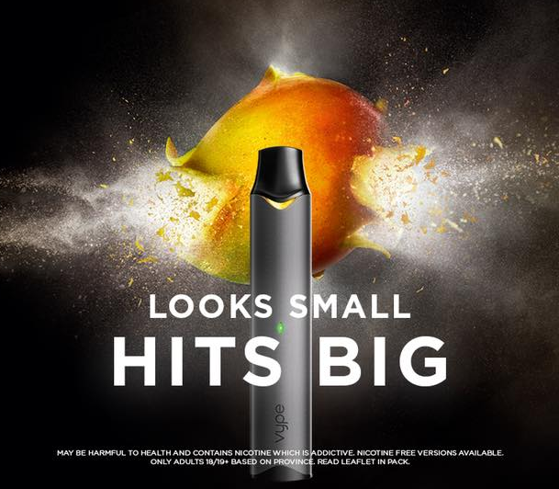
VS
Gum Ad
Vaping Ad
Photo from Unsplash.com
Notes:
flavourful, tastes good
Normal to have like a pack of gum

Slide 30


VS
Cigarette Ad
Vaping Ad
Photo from Unsplash.com

Slide 31
True or False
Youth are easily addicted to nicotine.
1
2
3
TRUE
Youth can get addicted at lower doses of nicotine.
Photo from Unsplash.com
Notes:
True
Youth are more easily addicted to nicotine than adults…even at lower doses of nicotine

Slide 32

Most contain nicotine!
Do e-juice/pods contain nicotine?
Notes:
Studies have shown that some e-juices that say zero nicotine actually contain some nicotine in them.
Cross contamination because they aren’t tested?
On purpose to hook their customers onto their products?
We don’t know!
Some brands don’t offer zero nicotine options.
Some brands are only offer high dosages of nicotine
***For you own knowledge***
Freebase nicotine (normal) VS Nicotine Salts
Nicotine salts are modified to lower the pH levels for a smoother feeling when used. Therefore pods/juice with nicotine salts can use a higher level of nicotine opposed to freebased nicotine.
Juul knew that smokers using traditional vapes weren’t quitting because the nicotine hit wasn’t strong enough so they started using nicotine salts for a greater nicotine hit with a smooth finish

Slide 33
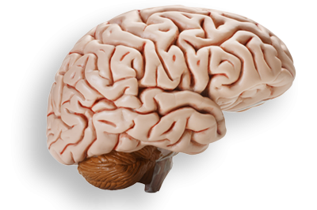
Vaping nicotine can alter teen brain development.
Notes:
Nicotine Impacts:
Nicotine alters the part of the brain that supports attention, focus and learning,
Alters the part of the brain that deals with addiction pathways
Youth get addicted quicker than adults and with lower levels of nicotine
Addiction to nicotine could result in cigarette use! (If students said cigarettes were bad for you at the beginning, remind them that cigarettes are bad and people are addicted to the nicotine in cigarettes)

Slide 34
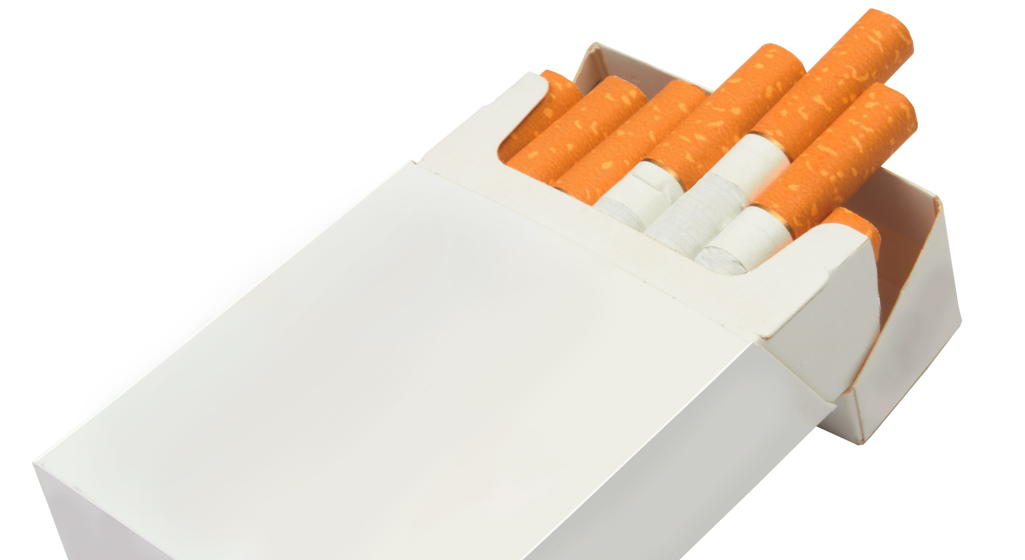
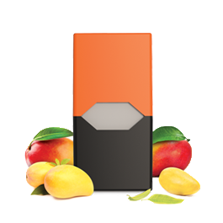
Nicotine
Nicotine
Some pods/e-juice contain more nicotine than a pack of cigarettes!
Notes:
Juul pods (shown) contain 3% or 5% of nicotine.
The 5% pods is equivalent to a pack of cigarettes. Juul also says its about 200 puffs per pod which also equals to a pack of cigarettes.
Nicotine levels for other e-juices – 0mg/mL, 3mg/mL, 6mg/mL, 12mg/mL, 18mg/mL (sometimes even as high as 24mg/mL or 36mg/mL)
NOTE: Some studies have shown that some e-juice that claims 0 nicotine actually contain some nicotine.
Juul pods are designed to NOT be refillable. Instead you would replace the empty pod with a new pod.

Slide 35

Vaping liquids containing nicotine is poisonous!
Is nicotine safe?
Notes:
Besides addiction, nicotine in liquid form is also poisonous.
Even in small amounts, vaping liquids containing nicotine can be very harmful if:
Swallowed
Absorbed through the skin
There have been fatalities as well as non-fatal nicotine poisoning caused by children swallowing vaping liquids
You also wouldn’t want your pets to swallow it.
There are even nicotine warnings on some of the packaging.
Do you really want to be inhaling things with health warnings?

Slide 36

What do you know about the vapours that are released?
Notes:
Ask students what they know about the vapours that are expelled when vaping
Are they saying it’s “water vapours” or “safe”? (misinformation)
(Click Next Slide)
Explain that its more than just water vapours

Slide 37
Not harmless water vapour…
It’s an aerosol!
Notes:
Water Bottle Spray VS Hairspray Canister
Water Bottle:
- If you take a water bottle and spray it on the palm of your hand you will have water vapours on your hand.
Once the water dries, your hand will be dry with no residue
Hairspray
If you take a hairspray canister and spray it on the palm of you hard and aerosol will be released onto your hand.
Once the aerosol dries, your hand will have a sticky residue on it
That sticky residue means that wasn’t just water on your hands
The aerosol from the vaping device has toxic chemicals and fine metal particles
Those chemicals and metal particles get stuck in your lungs – Possibly causing lung damage
Remember, the long-term health risks are still unknown!

Slide 38
Do you know what you’re inhaling?
No one does.
CADMIUM
LEAD
FORMALDEHYDE
ZINC
ARSENIC
Notes:
Chemicals used for flavour in vaping products are often used by food manufacturers to add flavours to their products.
BUT…
They may be safe to eat (ingest) but they have not been tested to see if they are safe to breathe in (Inhaled).
Issue… When you burn things or heat them up enough, new chemicals can be created and breathed in.
Studies are showing that you are inhaling micro particles and heavy metals.
2nd hand vapour contains toxic chemicals similar to those but at lesser levels. So even if you don’t vape but stand with a group of vapers, you are being exposed to chemicals. Long term health effects of 2nd hand vapour are still unknown.

Slide 39
True or False
Adults can legally buy and give vapes to children & youth.
1
2
3
FALSE
Photo from Unsplash.com
Notes:
Move on to next slide after revealing answer.

Slide 40

It is illegal to sell or supply vapes or vaping products to anyone under 19 years old.
$490 fine
Notes:
Vaping Products = E-juice, vapes, vaping components like batteries, atomizer
Sharing with friends is considered “supplying to youth” and could result in a charge.
Parents buying vapes for children is also considered illegal.
People caught supplying minors vaping products (also includes cigarettes) can face a fine of up to $490.

Slide 41


No vaping 20 metres from these places
$305 fine
Notes:
Vaping is not allowed where Smoking isn’t allowed.
That means:
No Vaping or Smoking anything 20 metres from:
Rec centre PROPERTY (not just the building)
School GROUNDS (not just the building)
Sports fields and spectator viewing areas
Playgrounds
Arena GROUNDS (not pictured)
It’s the Law.
People can be charged and fined.

Slide 42


Let’s Compare…
Cigarettes
Vapes
Addictive
Health Risks
Targets Youth
Marketing Strategies
Harmful Chemicals
Restricted Use
Photo from Unsplash.com
Notes:
Reiterate that cigarettes are bad. Read the list of how and why cigarettes are bad.
Then compare vapes to cigarettes. Ask students if vapes are: (then read off the list)
Are vapes addictive?
Do they have health risks?
Etc.

Slide 43
Notes:
Copy and paste the link to video if clicking play button doesn’t work: https://www.youtube.com/watch?v=mGaDhpXHWrQ
(Health Canada – Consider the Consequences)

Slide 44

Take Home Messages
1
Vaping is not intended for youth and non-smokers.
Photo from Unsplash.com
Notes:
Youth vaping will lead to a new generation of nicotine dependant youth
Good news is that most youth don’t vape!

Slide 45
Take Home Messages
2
Less harmful does not mean safe!
Photo from Unsplash.com
Notes:
To a person who is trying to quit smoking, vaping might be less harmful. But that doesn’t mean its safe.
It is already more harmful to a person who vapes but doesn’t smoke

Slide 46
Take Home Messages
3
Nicotine is addictive & poisonous.
Higher risk of cigarette use!
Photo from Unsplash.com
Notes:
Tobacco and vaping companies profit from addiction

Slide 47
Remember…
Youth who vape are
4x
more likely to start smoking cigarettes.
Photo from Unsplash.com
Notes:
Sources:
Cancer.org
https://www.cancer.org/latest-news/two-studies-highlight-tradeoffs-of-e-cigarettes.html
Ontario Lung Association

Slide 48
Take Home Messages
4
Long-term health risks are still unknown.
Photo from Unsplash.com
Notes:
It took the cigarette industry about 50 years to learn about the long-term health impacts of smoking
Even though long term health risks are still unknown, we do know they aren’t as safe as some people think.

Slide 49


