Slide 1

Slide 1
LPHAs can add their own logo
Date
Presenter
Student Leader Training
Date
Presenter
Notes:
Establish group norms for the training session. These can be changed to reflect your school’s specific rules.

Slide 2

You are a PALS Leader in your school
Get ready to:
Become a more confident leader
Help solve problems on the playground
Help younger students be more physically active
Make new friends
Make everyone feel included
Have fun!

Slide 3


The PALS Motto:
What do you think our motto means?
How can we demonstrate this motto on the playground as PALS leaders?

Slide 4
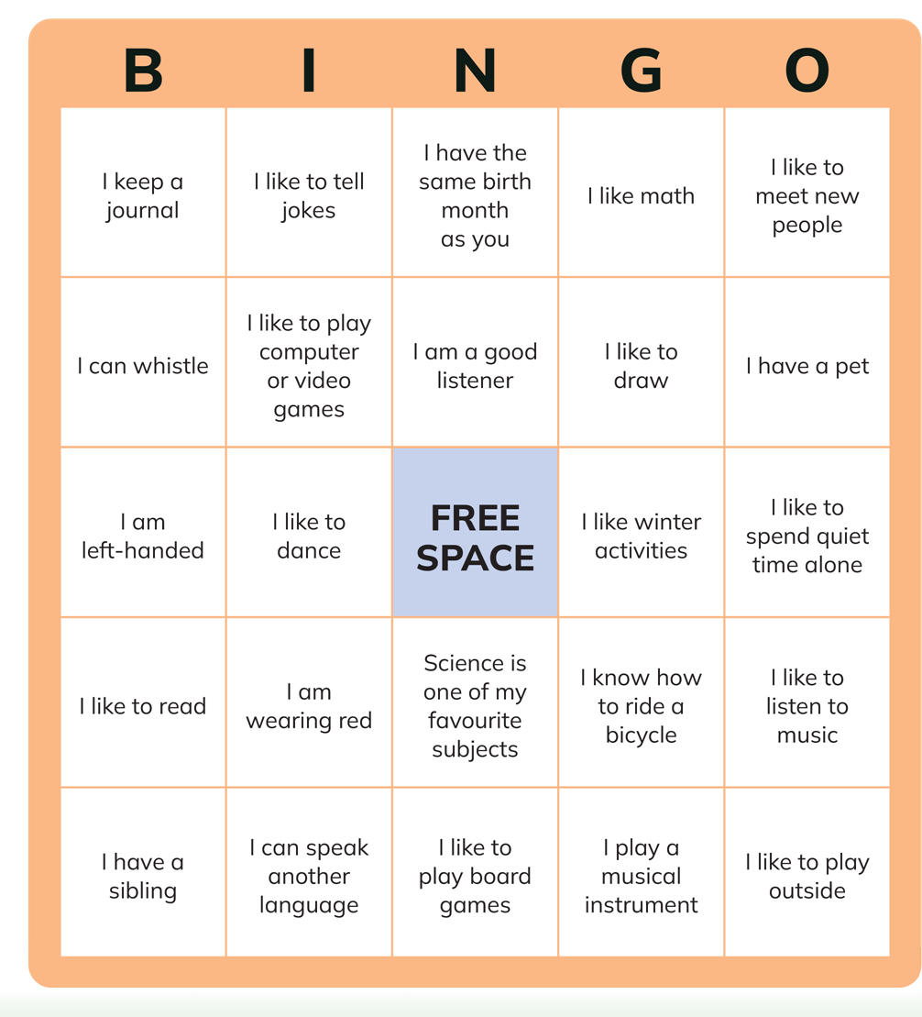
BINGO!

Slide 5

Leadership Skills

Slide 6

Communication Skills
Listening: How well I listen
Speaking: What I say and how I say it
Actions: What I do

Slide 7
Communication Skills Activity
Listening:
How well I listen

Slide 8
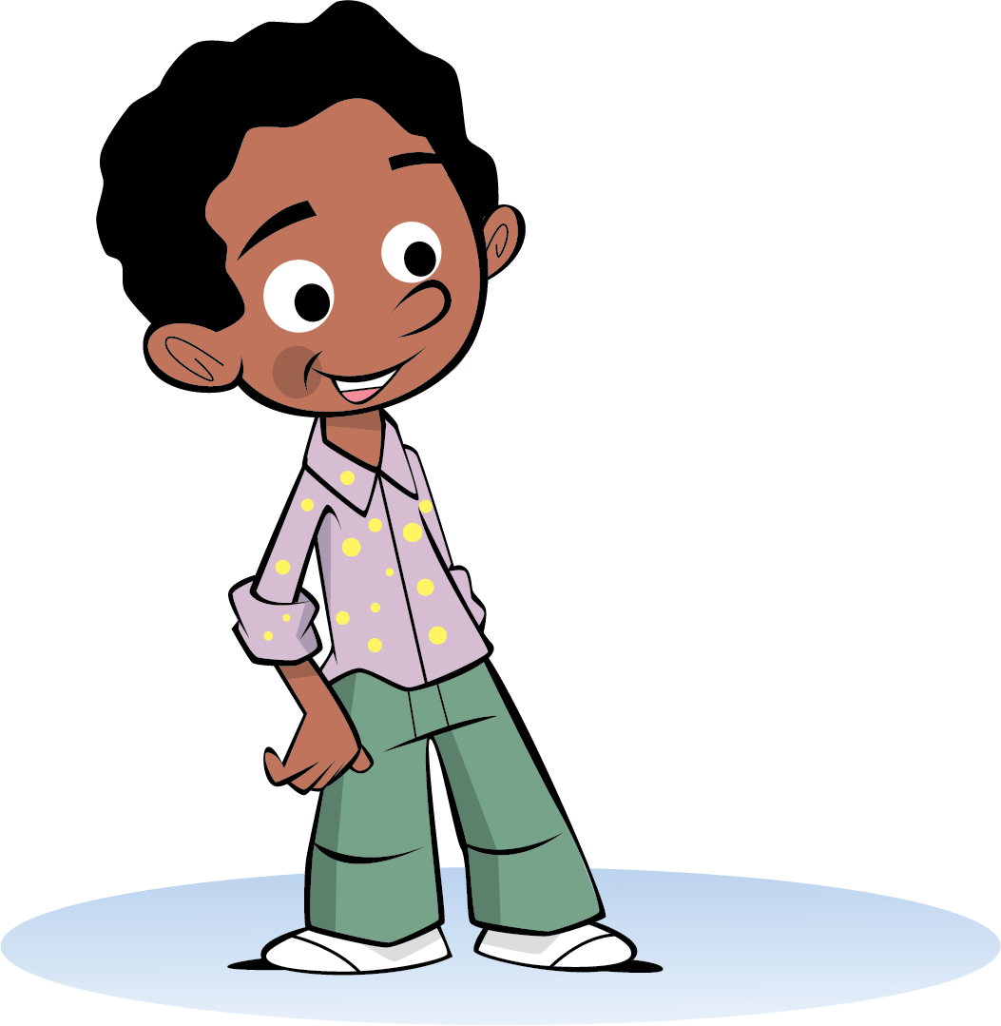
Communication Skills Activity
Speaking:
What I say and how I say it

Slide 9
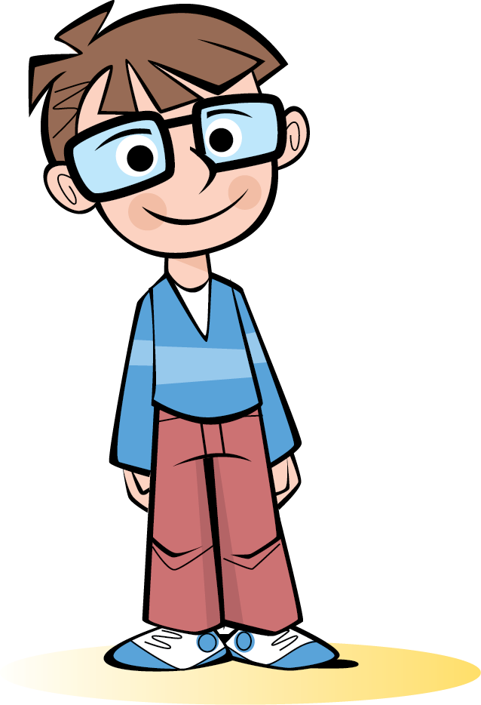
Communication Skills Activity
Actions:
What I do

Slide 10
Communicating as a PALS Leader
Practice time!
Leader A: “OK everyone, we’re supposed to work together to put away the playground equipment. You put the equipment away and let me know when you’re done.”

Slide 11
Communicating as a PALS Leader
Practice time!
Leader B: “Today we are going to learn a new game. First, we’ll read the instructions, so we know how to play. Then we’ll pick teams. Then we can practice. Does that sound good to everyone?”

Slide 12

Communicating as a PALS Leader
Practice time!
Leader C: “I’m the leader, so you have to do what I say, or I won’t let you play.”

Slide 13
Communicating as a PALS Leader
Practice time!
Leader D: “You're the best runner. Do you want to be IT? Does anyone know a tag game we can play?"

Slide 14
Communicating as a PALS Leader
Practice time!
Leader E: “I’m not sure what to do. Just do whatever you want.”

Slide 15






Conflict Resolution: Strategies

Slide 16
Conflict Resolution: Steps
1
Identify the conflict – what do we disagree about?
2
Listen to each other.
3
Speak calmly, using "I" statements to clarify.
4
See the issue from multiple perspectives – think about the disagreement from all sides.
Try to stay calm until you have a solution where all sides feel their needs have been met.
5

Slide 17


Fair Play

Slide 18

Let’s play a game!
Lightning in a Bottle
Notes:
JOANNA
CONSIDER ADDING MORE COMPLICATED GAMES AS EXAMPLES
Plan time during each training session to allow students to learn new games and practice communication skills.
This slide can be used to break up the training
This training is best done in the gym or outside, dependent on weather and space.
• If you have a large group of PALS leaders being trained you may want to divide the group into smaller groups.
• Have each group select games from different sections of the PALS Games Guide. For example, team, tag, ball, and skipping.
• Allow PALS leaders the opportunity to introduce and lead a game.
• Allow PALS leaders to rotate through the different games.
• You may also invite PALS leaders to share some of their own ideas and suggestions for new games.
• Have fun!

Slide 19

Let’s play a game!
Higher or Lower
Notes:
JOANNNA
Plan time during each training session to allow students to learn new games and practice communication skills.
This slide can be used to break up the training
This training is best done in the gym or outside, dependent on weather and space.
• If you have a large group of PALS leaders being trained you may want to divide the group into smaller groups.
• Have each group select games from different sections of the PALS Games Guide. For example, team, tag, ball, and skipping.
• Allow PALS leaders the opportunity to introduce and lead a game.
• Allow PALS leaders to rotate through the different games.
• You may also invite PALS leaders to share some of their own ideas and suggestions for new games.
• Have fun!

Slide 20

Let’s play a game!
Squirrels in the Tree
Notes:
Joanna
Plan time during each training session to allow students to learn new games and practice communication skills.
This slide can be used to break up the training
This training is best done in the gym or outside, dependent on weather and space.
• If you have a large group of PALS leaders being trained you may want to divide the group into smaller groups.
• Have each group select games from different sections of the PALS Games Guide. For example, team, tag, ball, and skipping.
• Allow PALS leaders the opportunity to introduce and lead a game.
• Allow PALS leaders to rotate through the different games.
• You may also invite PALS leaders to share some of their own ideas and suggestions for new games.
• Have fun!

Slide 21
PALS leader commitment
• Invite all students to join in and play the games.
• Lead activities and explain the rules clearly to everyone.
• Make sure I have all the equipment needed for the activity.
• Continue to learn new games.
• Attend PALS leader meetings.
• Be responsible to show up when I am scheduled. (except for illness).
• Role model fair play, good listening, and fun.

Slide 22
Slide 1
LPHAs can add their own logo
[LPHA to customize].
Notes:
Add PHU Contact Details:

